Slide 1
Introduction to Big Data Analytics
Dr. Leon Jololian

Slide 2
Topics Covered
Computing Environment:
Ubuntu operating system (Linux)
Bash shell
Python
Database:
Relational Database (MySQL)
Structured Query Language (SQL)
NoSQL Databases
Hadoop
The Hadoop Distributed File System
The MapReduce programming model
Multi-step processing

Slide 3
Topics Covered (continued)
Hadoop Ecosystem
Hive
Spark
Sqoop
Kafka

Slide 4
Data Science
Everyone has a slightly different definition of what is Data Science
Data analysis is used to provide value to the organization in order to make better decisions.
We explore data to reveal knowledge such as: new insights, patterns, trends, anomalies, and outliers.
Data visualization tools can help us better understand the analysis,
Programming + Algorithms
Mathematics
Domain Knowledge

Slide 5
The Importance of Data Analysis
Vast quantity of data available from massively varied sources such as: social media, sales data, log files, email, medical/patient information, sensor data, security cameras, and more.
The cost of data storage and computing power has been steadily decreasing over the last two decades.
Emergence of new tools that can automate the processing of massive data, such as machine learning, big data, cloud computing, data visualization, programming languages, etc.

Slide 6
Industry Statistics
According to the Gartner Research:
75% of the companies surveyed are either investing or planning to invest in Big Data solutions in the next two years.
According to IDC research:
Growth is 12% per year, whereas IT spending is increasing at the rate of 2% per year.
Web Economic Forum:
World’s best job and ranking is Data Scientist.

Slide 7
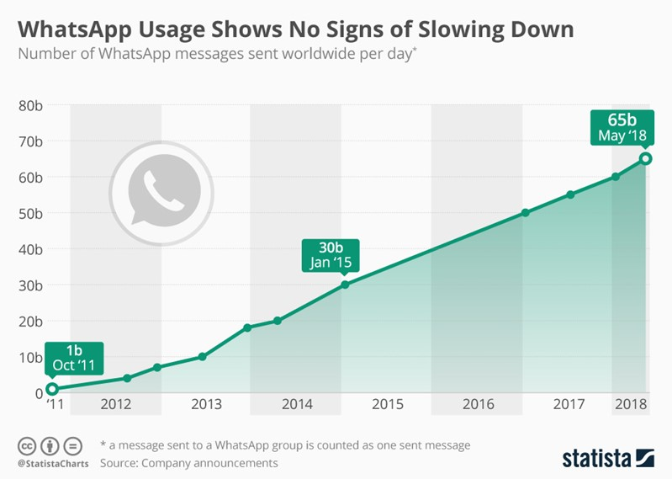

Slide 8
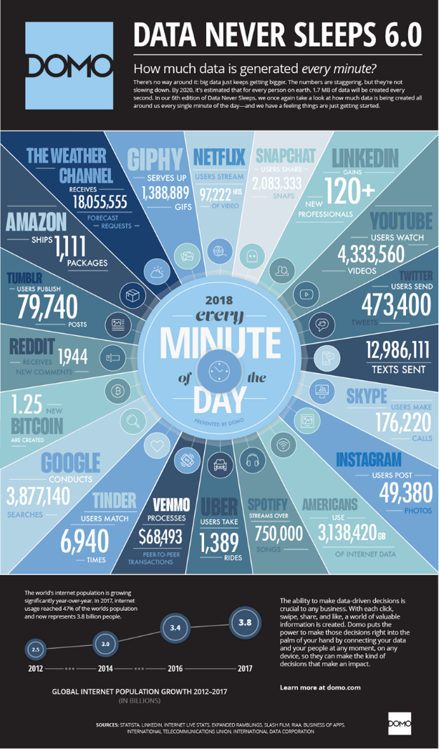

Slide 9
Data Explosion

Slide 10
Datafication
Units for measuring data:
Bit, Byte, Kilobyte (KB), Megabyte (MB), Gigabyte (GB), Terabyte (TB), Petabyte (PB), Exabyte (EB), Zetabyte (ZB), …
Common storage devices:
Hard disk = 1 TB
Mobile phone = 128 GB
Photo = 10 MB

Slide 11
Data Scale
Terabyte (1, 000, 000, 000, 000 Bytes)
10 Terabytes: The printed collection of the US Library of Congress
Petabyte (1, 000, 000, 000, 000, 000 Bytes)
2 Petabytes: All US academic research libraries
20 Petabytes: Production of hard-disk drives in 1995
Exabyte (1, 000, 000, 000, 000, 000, 000 Bytes)
5 Exabytes: All words ever spoken by human beings.
In the next decade, astronomers expect to generate approximately one Exabyte every four days of operation from the Square Kilometre Array (SKA) telescope.

Slide 12
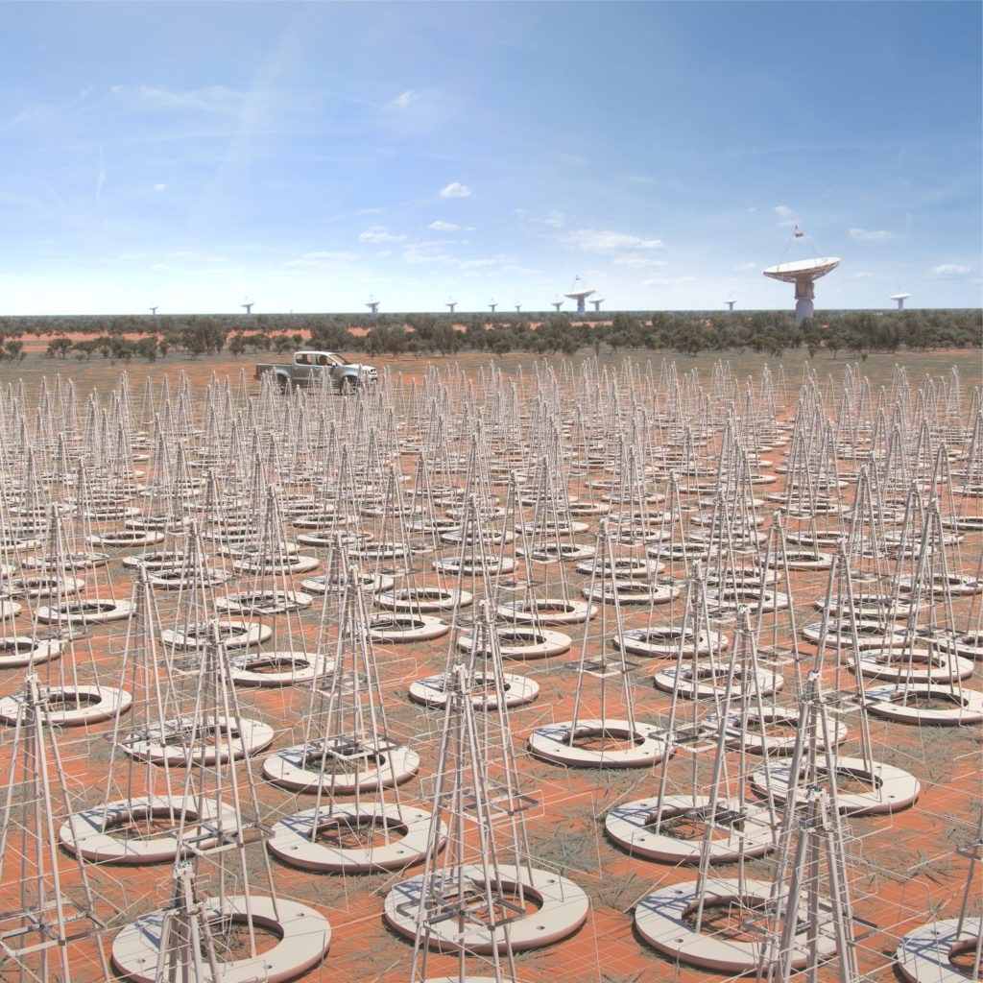
Hundreds of thousands and eventually up to a million low-frequency antennas will be located in Western Australia.

Slide 13
Data Scale (cont’d)
Zettabyte (1, 000, 000, 000, 000, 000, 000, 000 Bytes)
Research from the University of Southern California reports that in 2007, humankind successfully sent 1.9 zettabytes of information through broadcast technology such as televisions and GPS.
Yottabyte (1 000 000 000 000 000 000 000 000 Bytes)
Xenottabyte (1 000 000 000 000 000 000 000 000 000 Bytes)
Shilentnobyte (1 000 000 000 000 000 000 000 000 000 000 Bytes)
Domegemegrottebyte (1 000 000 000 000 000 000 000 000 000 000 000 Bytes)

Slide 14
Bottleneck in Data Processing
Hard Drives:
Seek Time: Time required for the head to point to the location on disk where the data is stored (~25 ms).
Transfer Time: Time required to transfer data from head to memory.
Hard drive speed is relatively flat.
Hard drive capacity keeps growing (4TB).
There is a throughput mismatch in accessing data:
Standard spinning hard drives: 60-100 MB/sec.
Solid state disks: 250-500 MB/sec.
Online data growth:
doubles every 18 months.
Processor speed/performance: similar growth.
Moving data on and off the disk is the bottleneck.

Slide 15
Example
To read 1 TB of data at 100 MB/sec takes 10,000 sec (~167 min)
At 500 MB/sec (SSD), it takes 2,000 sec (~33 min)
1 TB is considered a small file. The need for parallel data access (portions of data accessed at the same time) is essential for big data.
Hadoop uses the concept of “moving the computation to the data”.

Slide 16
Digital Trace
We are increasingly surrounded by sensors that collect and share data.
Everything that happens leaves digital trace.
Smartphones contain sensors such as:
A GPS sensor that can track where you are every second of the day.
An accelerometer to track the direction and speed
Smart TVs, smart watches, smart fridges, smart alarms, etc. are able to collect and process data.
Traffic sensors on the road send data to your alarm clock which will wake you up earlier than planned because the blocked road means you have to leave earlier to make your 9 am meeting.

Slide 17
Data is always increasing, but processing is not keeping up.
The Internet is one of the main reasons for the increased data.
Companies like Google, Yahoo, and Facebook, could not handle the volume of data. They had to find new solutions.
These companies started inventing solutions, initially as open source, then it became Apache Foundation projects.

Slide 18
Cost of Big Data
A decent 10TB hard drives costs at least $300.
To manage a PB of data that’s 100 x $300 USD = $30,000 USD. Even with a bulk discount and at 50% off we are well over $10,000 USD in storage costs alone.
Imagine if you wanted to actually do something with that data – like transform or copy it, or just keep a redundant version of it for disaster recovery. You’d need even more disk space!
If you’re not transforming and processing your data, you’re not extracting any insights out of it, and this brings us to our next problem – as there are no PB sized, single hard disks or SSDs on the market yet, how do you even connect to all these disk drives? Now you must deal with networking issues and optimizations, which is a whole new dimension of the problem space.

Slide 19
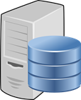

Prior to year 2000: Scaling vertically
2GB 8GB 32 GB
After year 2000: Scaling horizontally

Slide 20
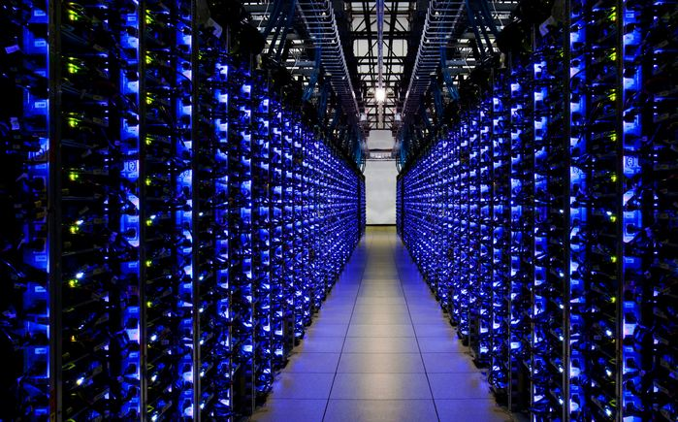
Data Center: racks of computers, each computer has its own memory and CPU.
Data is distributed and redundant.

Slide 21
What is Big Data?
It is the combination of infrastructure, algorithms, and visualizations, used to make sense of user and machine generated data.
Big data aims at gaining insight from data regardless of the size of the dataset.
Big data can answer:
What are my users doing in my applications?
What items or users are like each other?
What item might a user like?
What went wrong in my application or server?
What effect did a change in my app have on user behavior?

Slide 22
Big Data Infrastructure
The goals of big data infrastructure:
Scalability
Facilitate experimentation
Accessible across the organization
Search and discovery
Tools
Batch processing and storage (Hadoop)
Structured storage (Hbase, Casandra, MySQL)
Messaging (Kafka)

Slide 23
Big Data Algorithms
The goals of the algorithms is to:
Mine business intelligence from the data that users generate, that is actionable and provide insight that will help improve the business.
Make recommendation to users.
Automatically categorize things.
Math used in tools:
Probability
Statistics
Linear algebra
Regression analysis for predictions
Supervised learning or classification
Unsupervised learning or clustering

Slide 24
Big Data Visualization
The goals for visualization is to create:
Charts
Geographical mapping
Interaction
Animation
Libraries
Gnuplot
Matplotlib

Slide 25
Characteristics of Big Data
The 5 V’s of Big Data:
Volume: The amount of data that companies manage
Velocity: The speed with which data are being generated
Variety: The type of data (structured and unstructured) generated
Value: The transformation of data into actionable information
Veracity: The quality of the data

Slide 26
Volume
The volume of data that companies manage skyrocketed around 2012, when they began collecting more than three million pieces of data every day.
It is estimated that since then, this volume doubles about every 40 months.
Especially for B2C companies, Volume encompasses the available data that are out there and need to be assessed for relevance. For example:
Facebook has 2 billion users, Youtube 1 billion users,
Twitter has 350 million users, and
Instagram has 700 million users.
Every day, these users contribute to billions of images, posts, videos, tweets etc. You can now imagine the insanely large “volume” of data that is generated every minute and every hour.

Slide 27
Velocity
Data Velocity refers to the speed at which data is generated.
Processing the data can be done in various modes:
Batch – every night
Periodic – every hour
Near real-time – every few minutes
Real-Time – instantaneous

Slide 28
Business Advantage: High velocity data sounds great at its face – velocity x time = volume, and volume leads to insights, and insights leads to money.
Cybersecurity concerns: We always have to assume some percentage of incoming data is malicious. How to process every packet of data that comes through the firewall?
Processing Time: How to process high frequency data on the fly? not all collected data is important to the business.
Large swings in the amount of data processed every second. Twitter is much more active during the Super Bowl than at midnight on average Tuesday.

Slide 29
Variety
Data comes in a variety of ways:
Tables
Databases
Web
Social media
Sources of Data:
Bank, cars, mobile devices, IoT, airplanes, washing machines, smart TV’s, etc.

Slide 30
Variety in Big Data refers to all the structured and unstructured data that has the possibility of getting generated either by humans or by machines.
The most commonly added data are structured -texts, tweets, pictures & videos.
Unstructured data like emails, voicemails, hand-written text, ECG reading, audio recordings etc., are also important elements under Variety.
A company can obtain data from many different sources: from in-house devices to smartphone GPS technology or what people are saying on social networks.
The importance of these sources of information varies depending on the nature of the business. For example, a mass-market service or product should be more aware of social networks than an industrial business.

Slide 31
Value
Refers to the ability to transform a tsunami of data into business.
Example: knowing within a two-month period when it is highly likely that a customer will cancel his or her policy or purchase a new one.
Veracity
Veracity is equivalent to quality.
We have all the data, but could we be missing something?
Are the data “clean” and accurate?
Do they really have something to offer?

Slide 32
In addition to managing data, companies need that information to flow quickly – as close to real-time as possible.
For example, in social media, every day:
900 million photos are uploaded on Facebook,
500 million tweets are posted on Twitter,
0.4 million hours of video are uploaded on Youtube, and
3.5 billion searches are performed in Google.
Big Data helps the company cope with this massive data, accept the incoming flow of data and at the same time process it fast so that it does not create bottlenecks.
The data have to be available at the right time to make appropriate business decisions.
Sometimes Velocity can be more important than volume because it can give businesses a competitive advantage.

Slide 33
Imagine a booming business handling credit card transactions as a service to a growing number of clients, or a machine learning service that is constantly learning from a stream of tick-level stock data, or a social media giant with literally billions of clients making posts and comments and uploading videos and photos 24x7x365.
They deal with high velocity data. Every second, there are hundreds, if not thousands (or even millions for the rare, giant company) of transactions occurring, and this means data is being transferred from millions of laptops and mobile devices around the world to a “single” (well, hopefully well-distributed) data center every minute.
While there’s no hard and fast rule like a number of bytes per payload per millisecond or anything like that which practitioners might agree on as a strict threshold for high velocity data, if you’re beginning to encounter any of the following problems then you can safely qualify your data as high velocity.

Slide 34
Hadoop
Developed by Doug Cutting and Michael Cafarella
Hadoop is an open source, Java based framework used for storing and processing big data.
The data is stored on inexpensive commodity servers that run as clusters.
Its distributed file system enables concurrent processing and fault tolerance.
Hadoop uses the MapReduce programming model for faster storage and retrieval of data from its nodes. The framework is managed by Apache Software Foundation and is licensed under the Apache License 2.0.

Slide 35
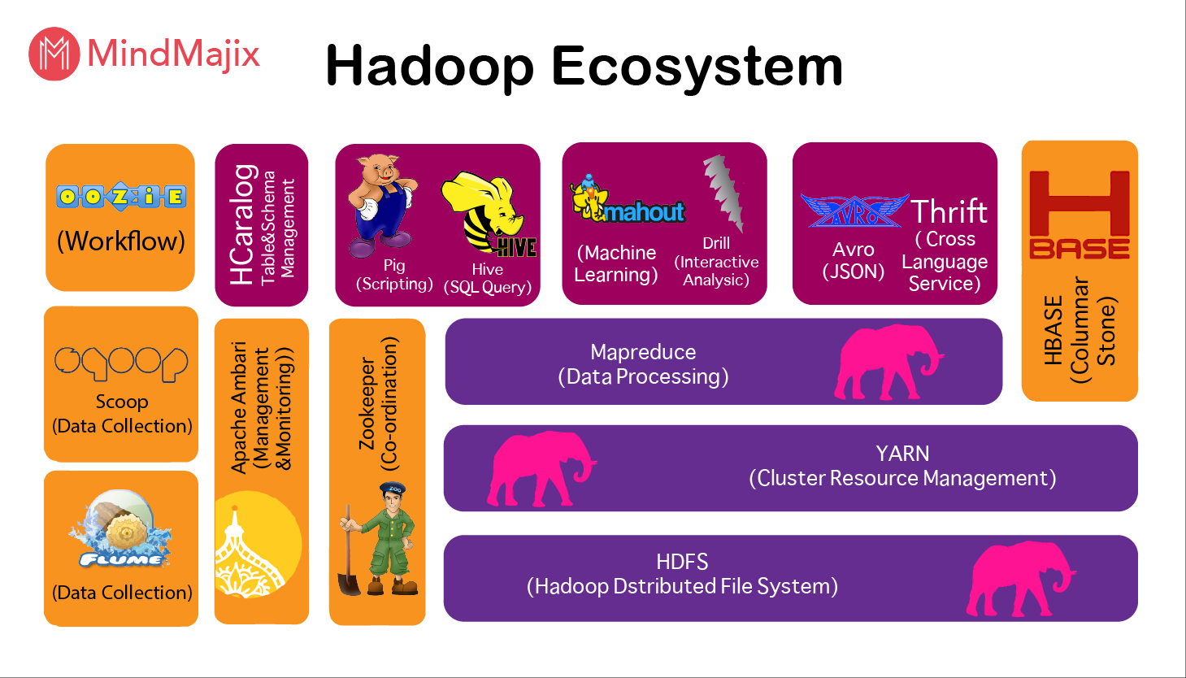
The Hadoop Ecosystem

Slide 36
YARN (Yet Another Resource Negotiator) acts as a brain of the Hadoop ecosystem. It takes responsibility in providing the computational resources needed for the application executions.
Apache Hive is a data warehouse open source software built on Apache Hadoop for performing data query and analysis.
Hbase is considered as a Hadoop database, because it is scalable, distributed, and because it is a NoSQL database that runs on top of Hadoop.
H Catalogue is a table and storage management tool for Hadoop.
Apache Pig is a high-level language platform for analyzing and querying large data sets that are stored in HDFS.
Apache Sqoop works as a front-end loader of Big data.
Apache Oozie is a tool in which all sort of programs can be pipelined in a required manner to work in Hadoop's distributed environment.
Apache Avro works as a data serialization system.
Apache Zookeeper is designed to coordinate multiple services in the Hadoop ecosystem.

Slide 37
Important Characteristics of Hadoop
Hadoop has the ability to store and process huge amounts of any kind of data, quickly. With data volumes and varieties constantly increasing, especially from social media and the Internet of Things (IoT), that's a key consideration.
Computing power. Hadoop's distributed computing model processes big data fast. The more computing nodes you use, the more processing power you have.
Fault tolerance. Data and application processing are protected against hardware failure. If a node goes down, jobs are automatically redirected to other nodes to make sure the distributed computing does not fail. Multiple copies of all data are stored automatically.
Flexibility. Unlike traditional relational databases, you don’t have to preprocess data before storing it. You can store as much data as you want and decide how to use it later. That includes unstructured data like text, images and videos.
Low cost. The open-source framework is free and uses commodity hardware to store large quantities of data.
Scalability. You can easily grow your system to handle more data simply by adding nodes. Little administration is required.

Slide 38
Limitations of Hadoop
Steep Learning Curve
It is a complex ecosystem.
the need for advanced technical knowledge to perform Hadoop functions.
Different Datasets Require Different Approaches
no 'one size fits all' solution.
components discussed above have been built in response to a gap that needed to be addressed.
For example, Hive and Pig provide a simpler way to query the data sets. Flume and Sqoop help gather data from multiple sources.
Limitations of MapReduce
Not well-suited for real-time or interactive data analytics.
Data Security
big data gets moved to the cloud.
There needs to be appropriate authentication, provisioning, data encryption, and frequent auditing.

